Slide 1
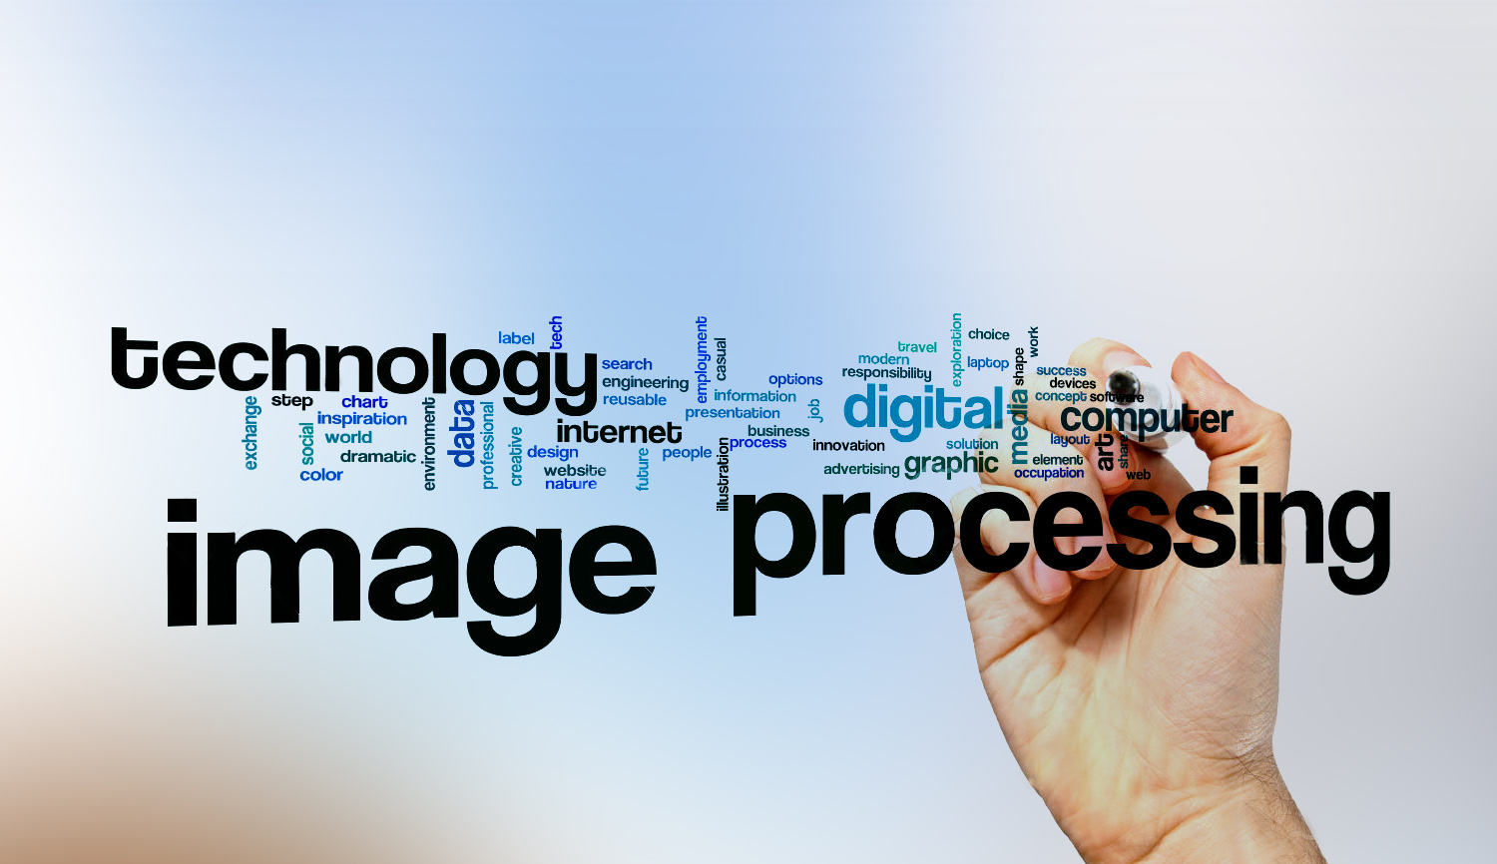
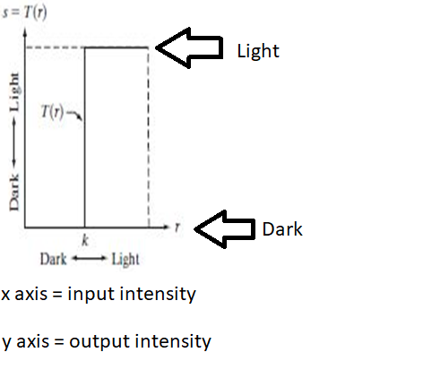
Digital Image Processing
14-Draw the transformation intensity function for transforming an image for black and white

